Slide 1
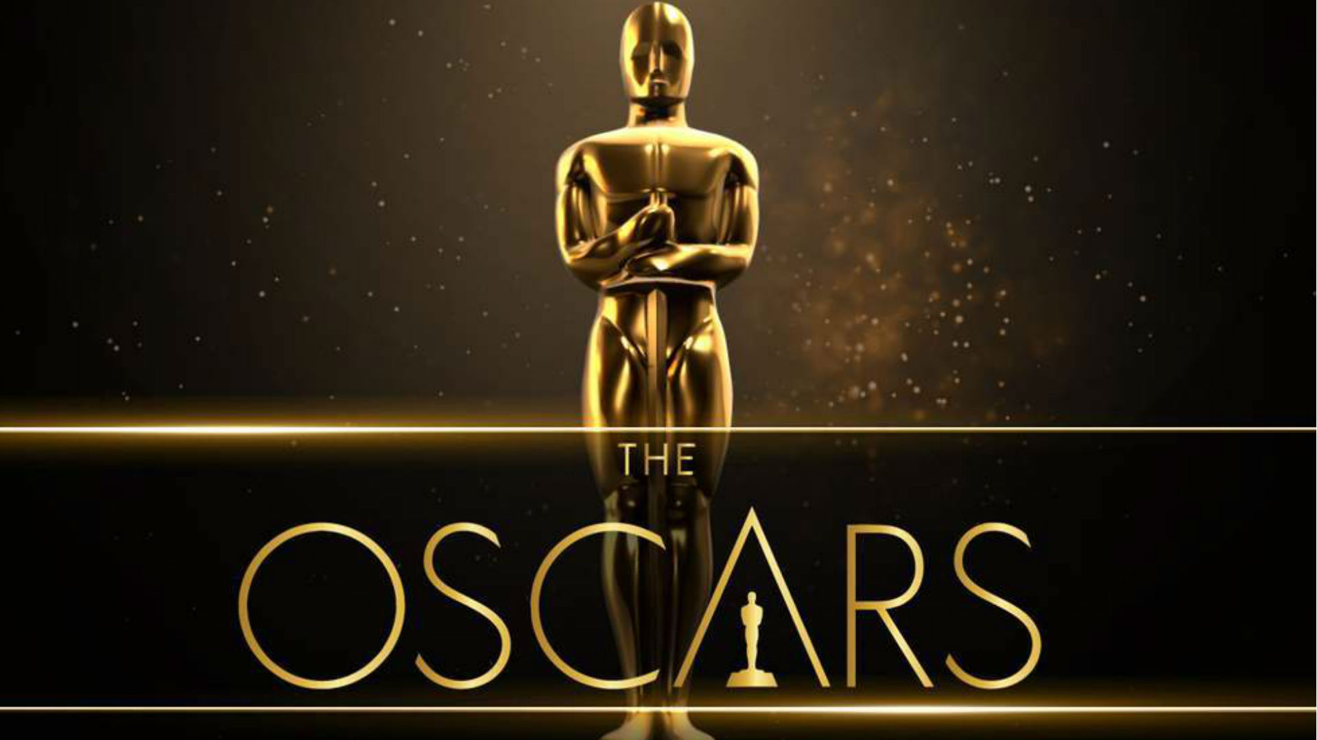

Slide 2
MOVIES THAT WON THE MOST OSCARS?

Slide 3
MOVIES THAT WON THE MOST OSCARS
The Lord of the Rings: The Return of the King (2003)
Ben-Hur (1959)
Titanic (1997)
11 OSCARS

Slide 4
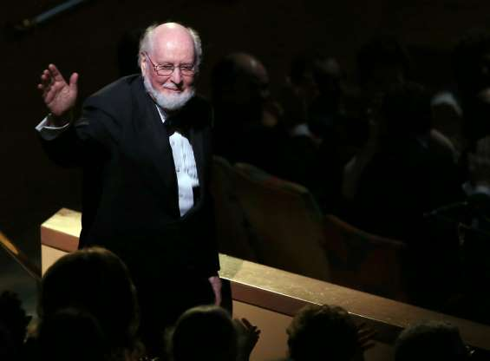
INDIVIDUAL WHO WON THE MOST OSCARS?
Music composer John Williams is the most Oscar-nominated person alive today, with 49 nominations and 5 wins.

Slide 5
I WOULD LIKE TO THANK MY SPOUSE…
V/S
Thank Their Husband Once in Seven Speeches
Thank Their Wife Once in Four Speeches
Courtesy of the Husbands, ‘Wife’ was one of the top 20 words used in the speeches for the first time in 80’s

Slide 6
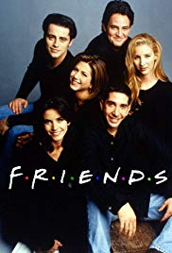
I WOULD LIKE TO THANK MY FRIENDS AND FAMILIES…
V/S
=

Slide 7
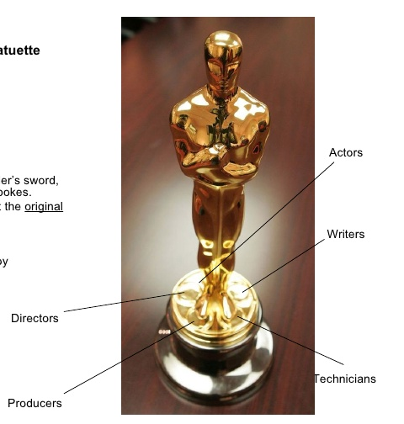
MENTIONS IN TOP 20 WORDs OVER 8 DECADES OF THE OSCARS
Appeared for the first time in 50’s
Failed to get more than 20 mentions in a single decade and were never in the top 20 words
Appeared for the first time in 60’s
Got more mentions than directors and producers in 80’s

Slide 8
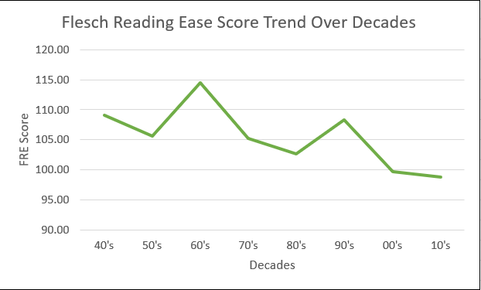
SPEECHES GETTING DIFFICULT OVER THE DECADES
The Flesch Reading Ease Readability Formula The specific mathematical formula is: RE = 206.835 – (1.015 x ASL) – (84.6 x ASW) RE = Readability Ease ASL = Average Sentence Length (i.e., the number of words divided by the number of sentences) ASW = Average number of syllables per word (i.e., the number of syllables divided by the number of words) • Scores above 90 are considered easily understandable by an average 5th grader. • Scores between 60 and 70 are considered easily understood by 8th and 9th graders. • Scores between 0 and 30 are considered easily understood by college graduates.

Slide 9
ALL THE WORDS USED IN THE SPEECHES…

Slide 10
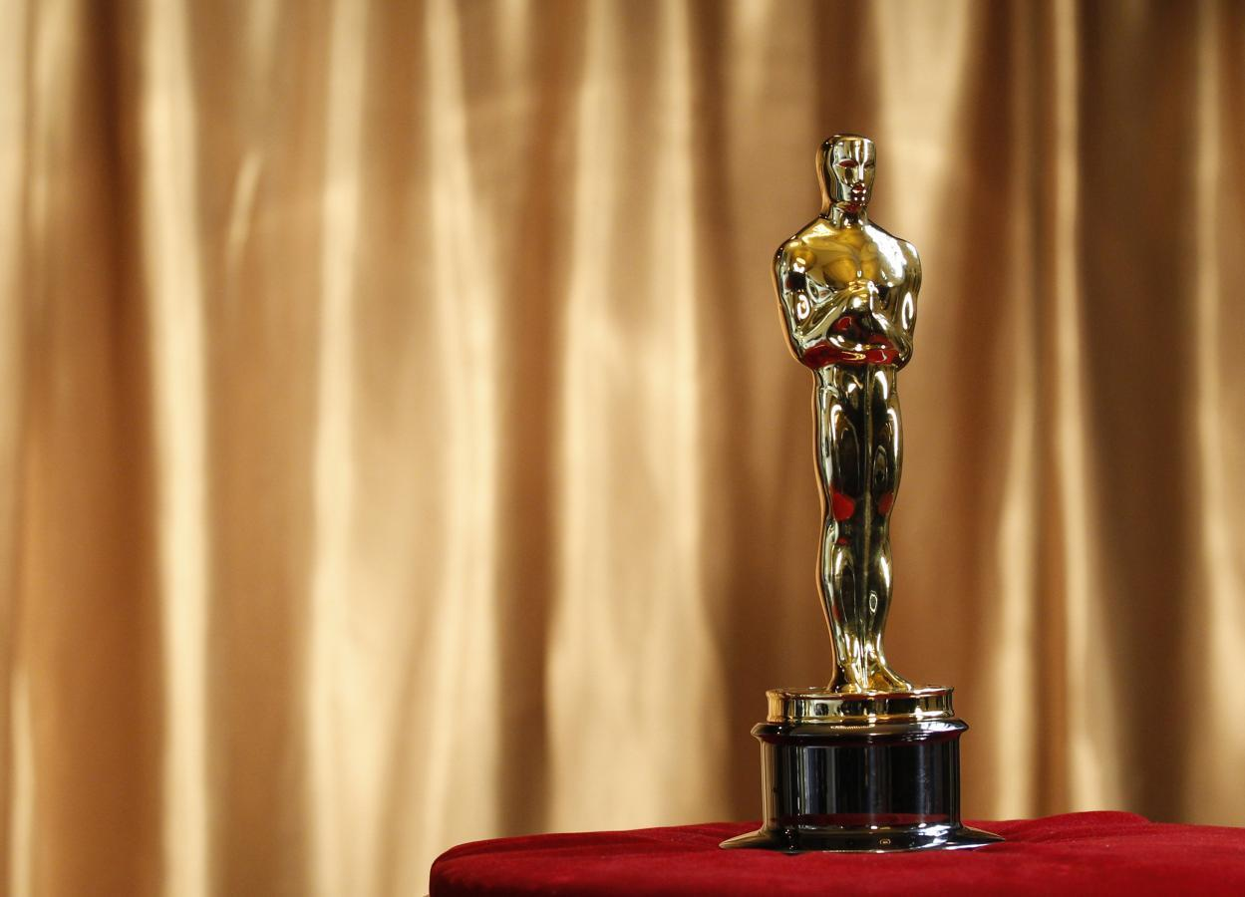
THANK YOU!!!

