Slide 1
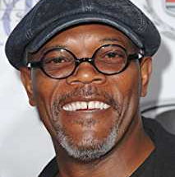
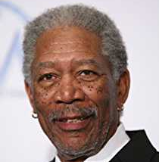
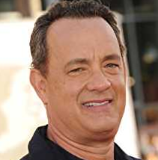
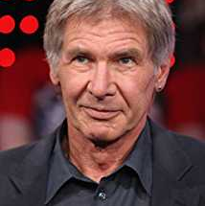
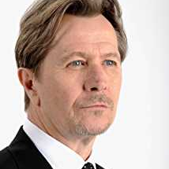
Samuel L. Jackson
Morgan Freeman
Tom Hanks
Harrison Ford
Gary Oldman

Slide 2
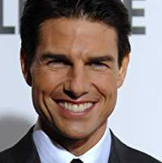
Samuel L. Jackson
Harrison Ford
Morgan Freeman
Tom Hanks
Tom Cruise

